Slide 1

Data Communication Networks ECM2001
2 | 0 | 2 | 4 | 4
Dr.T.Jayavignesh
Assistant Professor(Sr),
School of Electronics Engineering (SENSE),
VIT University, Chennai Campus
E-mail: jayavignesh.t@vit.ac.in
Cabin No : 36, 4th Floor Annexe
(M) : 9840437345

Slide 2
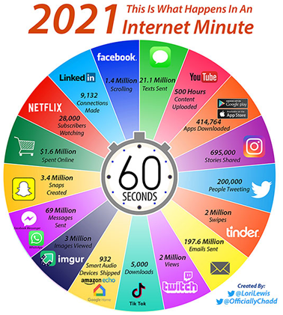

Slide 3
Course Objectives
PREREQUISITES | ECM1002 - ANALYSIS OF DATA STRUCTURE AND ALGORITHM
OBJECTIVES | To understand the split up of network functionality into layered tasks and services. To familiarize the functions and protocols of each layer of TCP/IP protocol suite. To understand the flow of information from one node to another node in the network and learn concepts related to network addressing To understand the components required to build different types of network.
LEARNING OUTCOMES | An ability to understand that message transmission/reception involves several layered tasks and services, protocol data units to convert message to packets to bits to signals, process of encapsulation and decapsulation mechanisms, concept of addressing to send/receive from intended source and destination. An ability to understand the functionality of internetworking devices and apply the knowledge to configure and troubleshoot it. Also, ability to understand several physical interconnection structures between end devices and internetworking devices An ability to interpret, design and analyze the error control, flow control protocols and algorithms An ability to understand medium access control protocols and algorithms for different LAN, WAN standards and life-long learning on evolution of network technologies and standards. An ability to understand the IP addressing structure and depending on requirements, configure, subnet and manage small size networks. Also, to design and analyze routing protocols and algorithms involved in finding the optimal path between source and destination and understand router look-up table mechanisms to forward the data to the correct outgoing interface An ability to understand how the choice of transport layer protocol influences the QoS metrics of applications. An ability to understand the functionalities of different application layer protocols and network security issues. An ability to design, build and analyze the layered protocols and algorithms, performance of internetworking devices, various LAN, WLAN standards using simulation tools or in real-time.

Slide 4
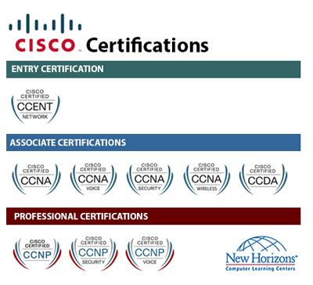
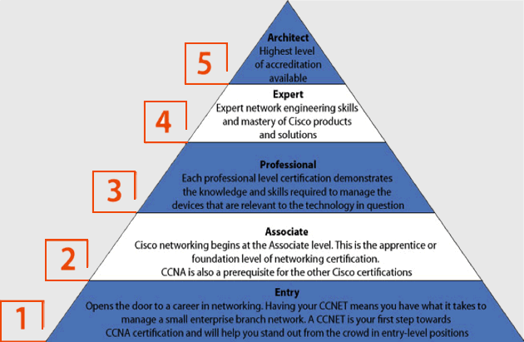

Slide 5
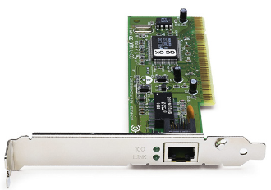
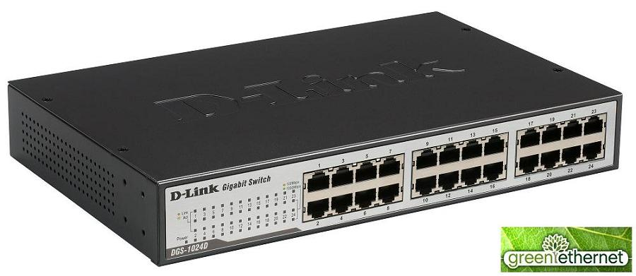
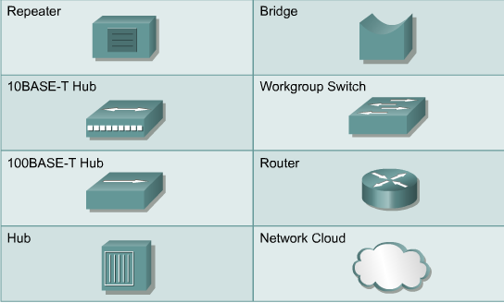
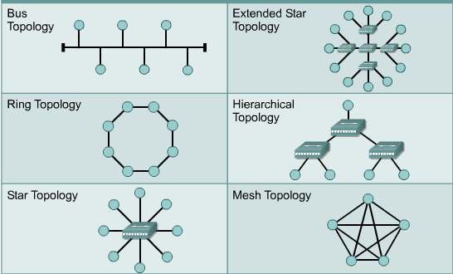
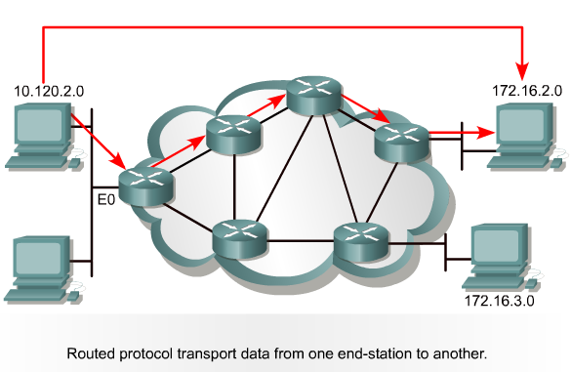

Slide 6
MAJOR REFERENCES
Alberto Leon-Garcia, “Communication Networks” Tata McGraw-Hill 2013.
Behrouz.A. Forouzan, “Data Communication and Networking”, Tata McGraw Hill, New Delhi, 4th edition

Slide 7
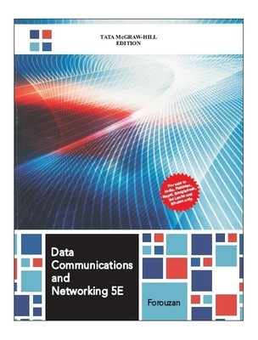


Slide 8

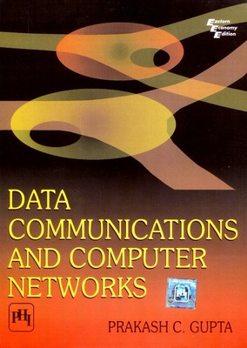

Slide 9
EVALUATION METHOD – ACADEMIC CALENDAR
Event | Period | Weightage
CAT-I | 27-08-2022 to 04-09-2022 | 15 marks
Digital Assignment 1 | Before CAT 1 | 10 marks
CAT-II | 08-10-2022 to 16-10-2022 | 15 marks
Digital Assignment 2 | Before CAT 2 | 10 marks
Quiz 1 | Before FAT | 10 marks
FAT | 14- | 40 marks

Slide 10
What is Expected?
Fullest Cooperation by attending the class regularly.
Avoid Getting Debarred < 75% attendance
Proposing – Team Based Digital Assignment {3 per Team}. The same Team for “J” preferred!
Learn the maximum out of this course.
100% Results – Let’s work for it!!

Slide 11
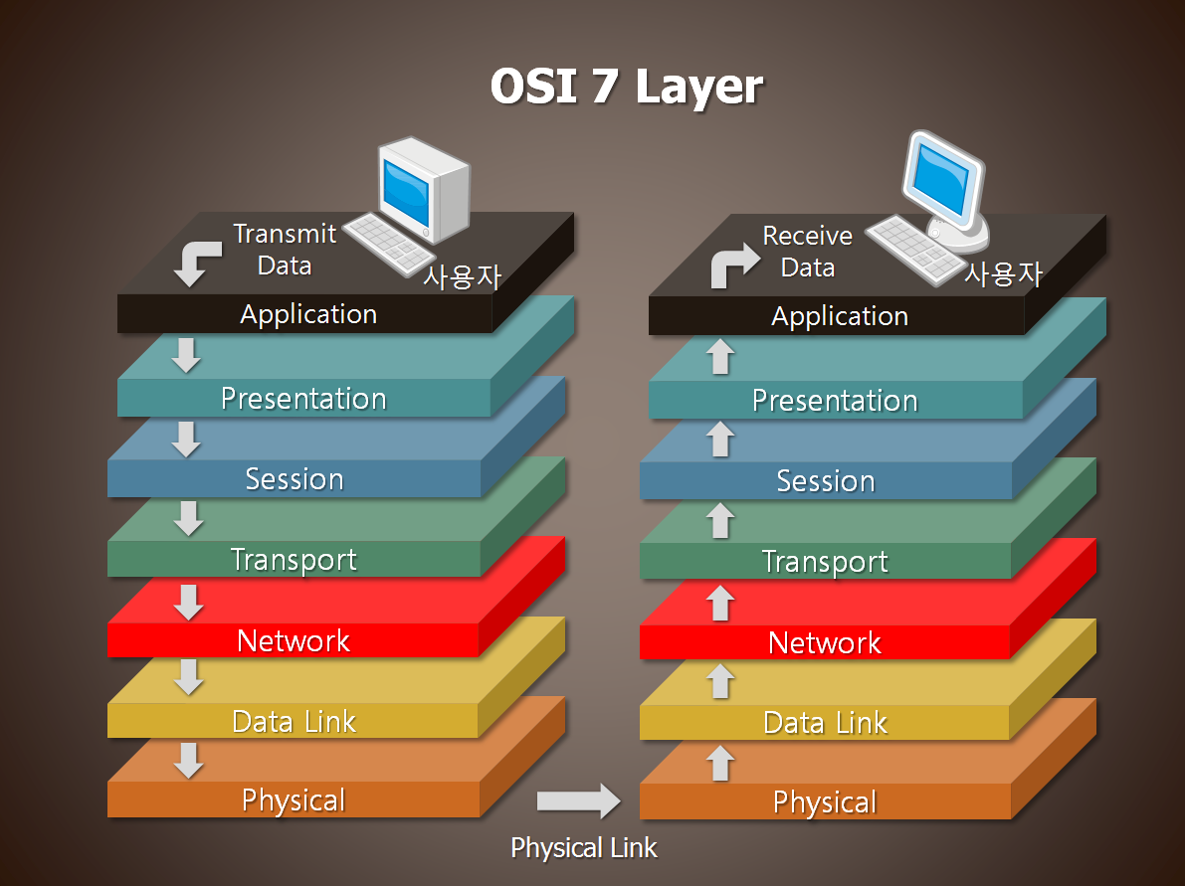

Slide 12
Module I – Introduction
Evolution of computer communication networks;
ISO/OSI reference model;
TCP/IP protocol suite,
Performance metrics of computer communication networks
Data rate limits.
B-ISDN protocol reference model.

Slide 13
Module II – Physical Layer
Multiplexing,
Switching techniques,
Network topologies,
Networking devices.

Slide 14
Module III – Logical Link Layer
Logical link control
Error detection and correction techniques
ARQ protocols
Framing
HDLC
Point to point protocol.
Broadcast and multicast protocol.

Slide 15
Module IV – Medium Access Control Layer
Random access protocols,
Aloha,
Slotted Aloha,
CSMA,
CSMA/CD,
CSMA/CA,
Token ring,
Token bus,
FDDI,
Ethernet,
Frame relay,
Virtual LANs

Slide 16
Module V – Network Layer
Internetworking
IP Addressing
Subnetting
IPv4 and IPv6
Routing
Distance Vector
Link State Routing
Routing Protocols

Slide 17
Module VI – Transport Layer
The transport service : Elements of transport protocols,
Congestion control algorithms,
Quality of service,
Internet transport protocols: UDP, TCP,
Performance issues,
Delay tolerant networks

Slide 18
Module VII – Application Layer
DNS- domain name system,
world wide web,
real-time audio and video,
content delivery and peer-to-peer,
SMTP and HTTP protocol,
network security - cryptography,
symmetric-key algorithms,
public-key algorithms
RIP,
SNMP

